Slide 1
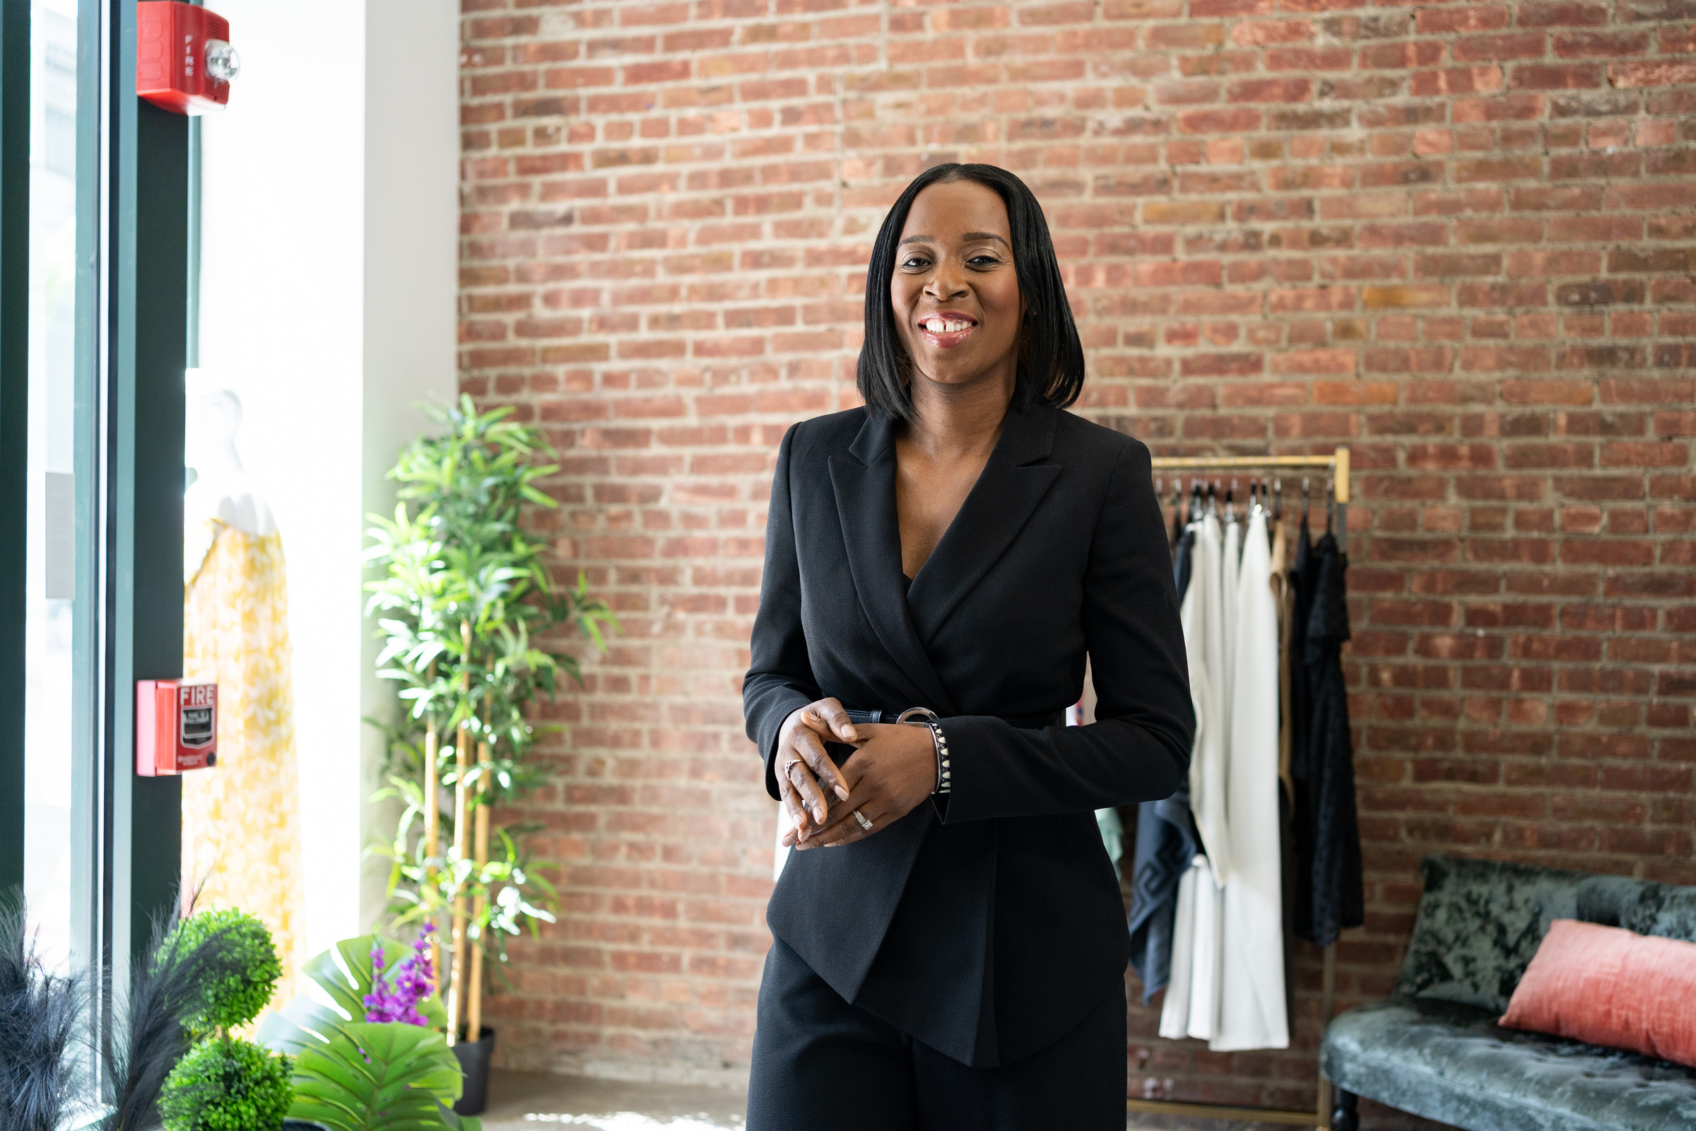



THE
BLAC LIST
Brand Style Guide

Slide 2

THE BLAC LIST
Find and Be Found
The BLACQList is a game-changing platform, emphasizing unity and empowerment within the commercial industry. It serves as a beacon for Black-Owned Businesses, Professionals, Creatives, Events, and Job Opportunities. The platform's mission is to uplift, support, and connect the vast potential of Black entrepreneurs and talents. Unlike any other, The BLACQList is a specialized platform designed to foster partnership and economic growth within the Black community.

Slide 3


BRAND COLORS
Process (CMYK) & Spot Colors
We established official brand colors for The BLACQList to retain brand continuity across all usages. Colors references from Pantone Color System for globally accurate color communication. Each brand asset in this document is set up for production-ready printing using either process or spot Pantone colors.
THE BLAC LIST
Find and Be Found
PANTONE CMYK COATED
THE
BLAC LIST
PANTONE
NEUTRAL BLACK C
PANTONE
151 C
PANTONE
7555 C
PANTONE
284 C
PANTONE
7443 C
HEX & RGB VALUES
THE BLAC LIST
#000000
RGB(0, 0, 0)
#595758
RGB(30, 34, 170)
#E2A428
RGB(255, 130, 0)
#FFD867
RGB(118, 176, 229)
#FFFFFF
RGB(233, 233, 247)
Find and Be Found

Slide 4

BRAND TYPOGRAPHY
Font Usage
We recommend utilizing these brand-approved fonts that work well with THE BLACQList’s aesthetic. This font family can be used in the design of your printed material to retain continuity over time and build brand equity. Additional font information linked below.
For headline or title usage,
For headline or title usage,
GLACIAL INDIFFERENCE
BOLD ITALIC
GLACIAL INDIFFERENCE
BOLD ITALIC
AABBCCDDEEFFGGHH
IIJJKKLLMMNNOOPP
QQRRSSTTUUVVWW
XXYYZZ
1234567890
AABBCCDDEEFFGGHH
IIJJKKLLMMNNOOPP
QQRRSSTTUUVVWW
XXYYZZ
1234567890
The BLACQList
@theblacqlist
For subhead or title usage,
For text or title usage,
Lato
Regular
Quicksand
Bold Italic
AaBbCcDdEeFfGgHh
IiJjKkLlMmNnOoPp
QqRrSsTtUuVvWw
XxYyZz
1234567890
AaBbCcDdEeFfGgHh
IiJjKkLlMmNnOoPp
QqRrSsTtUuVvWw
XxYyZz
1234567890

Slide 5

PRIMARY BRAND GRAPHICS
Process Color Logo Files
Process color logo files should be used for all off-set printed or digitally printed pieces done in full color. You can use it for collateral like brochures or yearbooks, signage, trade show banners, posters, or stickers. It can also be used to create web or on-screen graphics as well.
The BLACQList
Find and Be Found
PROCESS

Slide 6

PRIMARY BRAND GRAPHICS
PROCESS FORMATS: 1-3
Process Color Logo Files
THE
BLAC LIST
THE BLAC LIST
Find and Be Found
THE BLAC LIST

Slide 7
PRIMARY BRAND GRAPHICS
B&W Logo Files
Black and white logo files should be used for all offset printed or digitally printed pieces done in one color only. An example usage would be a simple flyer, memo, or fax cover sheet.
THE BLAC LIST
BLACK/WHITE

Slide 8
PRIMARY BRAND GRAPHICS
PROCESS FORMATS: 1-3
B&W Logo Files
THE
BLAC LIST
THE BLAC LIST
Find and Be Found
THE BLAC LIST

Slide 9
IMPROPER USAGE OF
BRAND GRAPHICS
WHAT NOT TO DO
The new brand graphics are very flexible, but there are still instances in which specific treatments are considered inappropriate and should be considered a violation of brand styling.
These showcased examples will help you avoid misuse and keep your brand aesthetic consistent moving forward and apply to all graphic assets documented in this brand style guide.
The BLACQList
Find and Be Found
DESIGN RULES

Slide 10




IMPROPER USE OF LOGO
THE
BLAC LIST
What Not to Do
The guidelines below will help ensure that your new brand assets remain consistent across all media. Please refer to this document whenever you are creating new printed material or merchandise. These simple rules apply to all brand assets showcased in this document.
Clear Space
Effects
Obstruction
Colors
Transparency
As a design rule of thumb, keep a buffer of space around brand graphics.
Never warp or discolor any brand graphic asset.
Never add-too or cover a brand graphic asset with another object.
Never alter the color of any brand graphic asset.
Never apply transparency
to any unsanctioned brand asset.
Black🖤
Distortion
Added Type
Alterations
Orientation
Editing
Never distort any brand graphic asset. Size all brand assets proportioanately.
Never add any additional text to a brand asset.
Never alter existing brand assets by adding outlines or applying more color.
Never rotate any brand asset from it's original orientation.
Never delete or change any elements within a brand graphic.

Slide 11

PRIMARY BRAND IMAGERY
Brand Voice and Imagery
Brand Imagery is one tool within this Brand Identity kit that defines the aesthetic appearance of your brand's core messaging. Brand imagery is one visual story-telling component of The BLACQList Brand Identity, and must be adhered to in order to maintain the brand's integrity.
Imagery
THE BLAC LIST

Slide 12
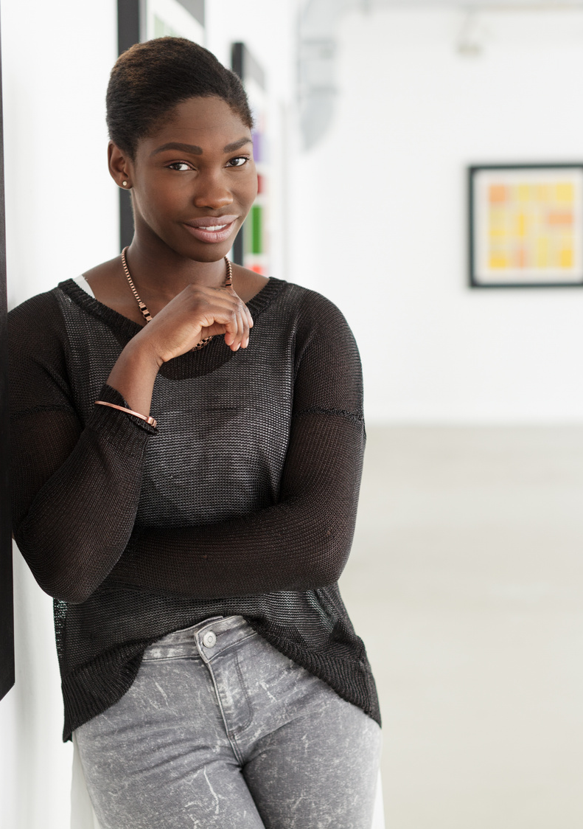

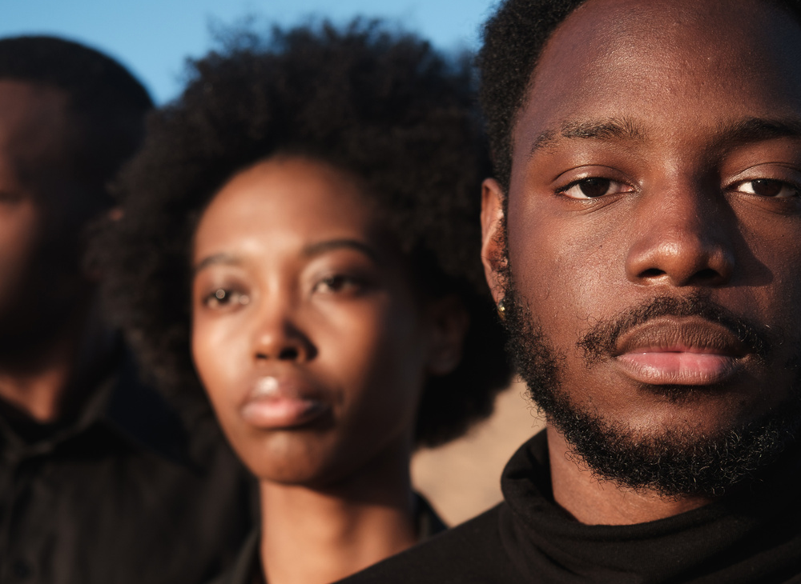
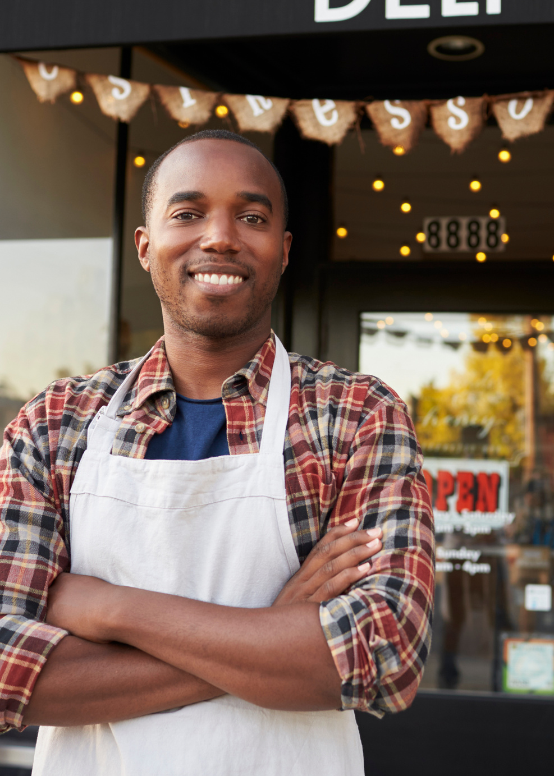
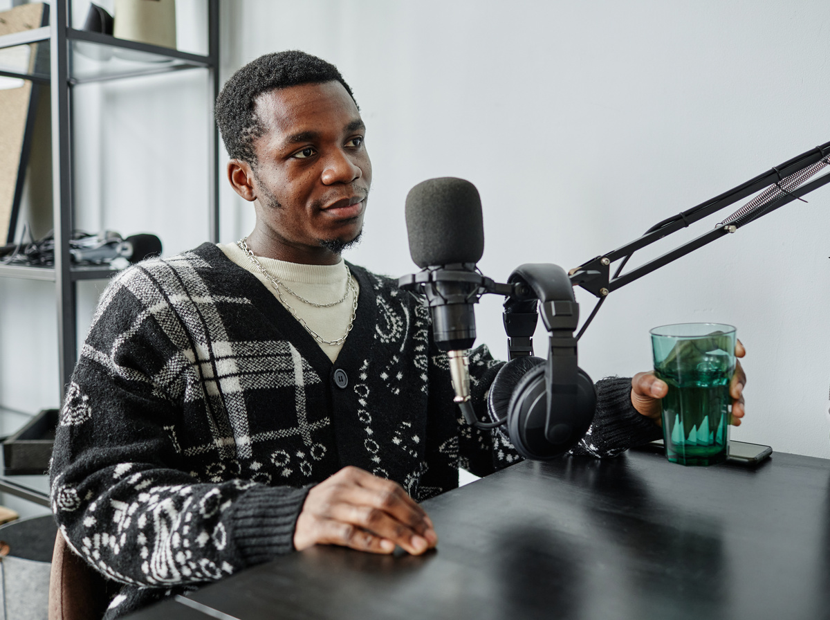
PRIMARY BRAND
VOICE
Empowering
Informed
Energetic
Supportive
Progressive
Coarse
Dry
Romantic
Sarcastic
Snarky

Slide 13

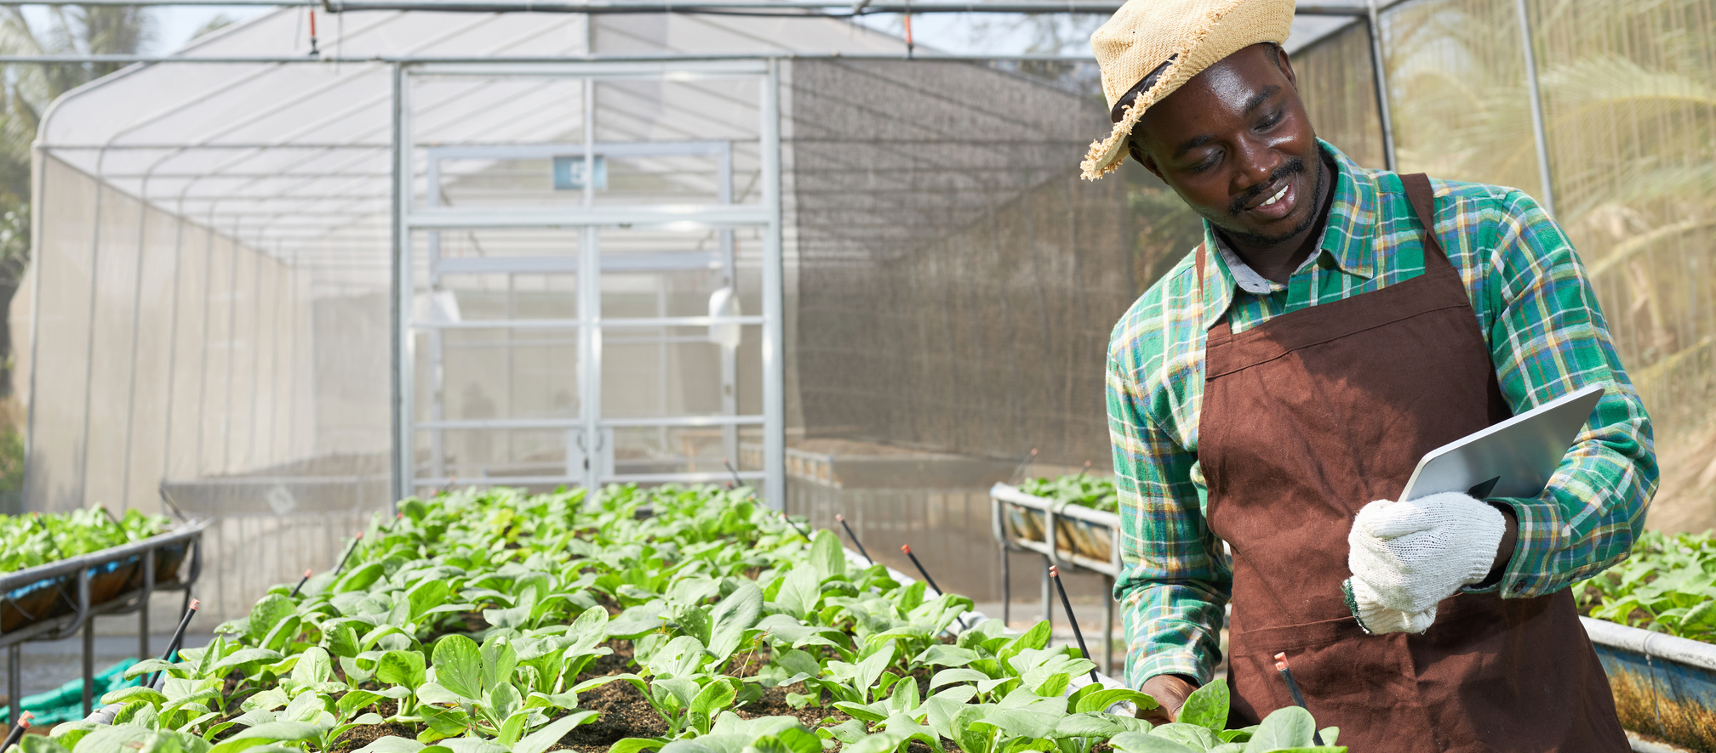

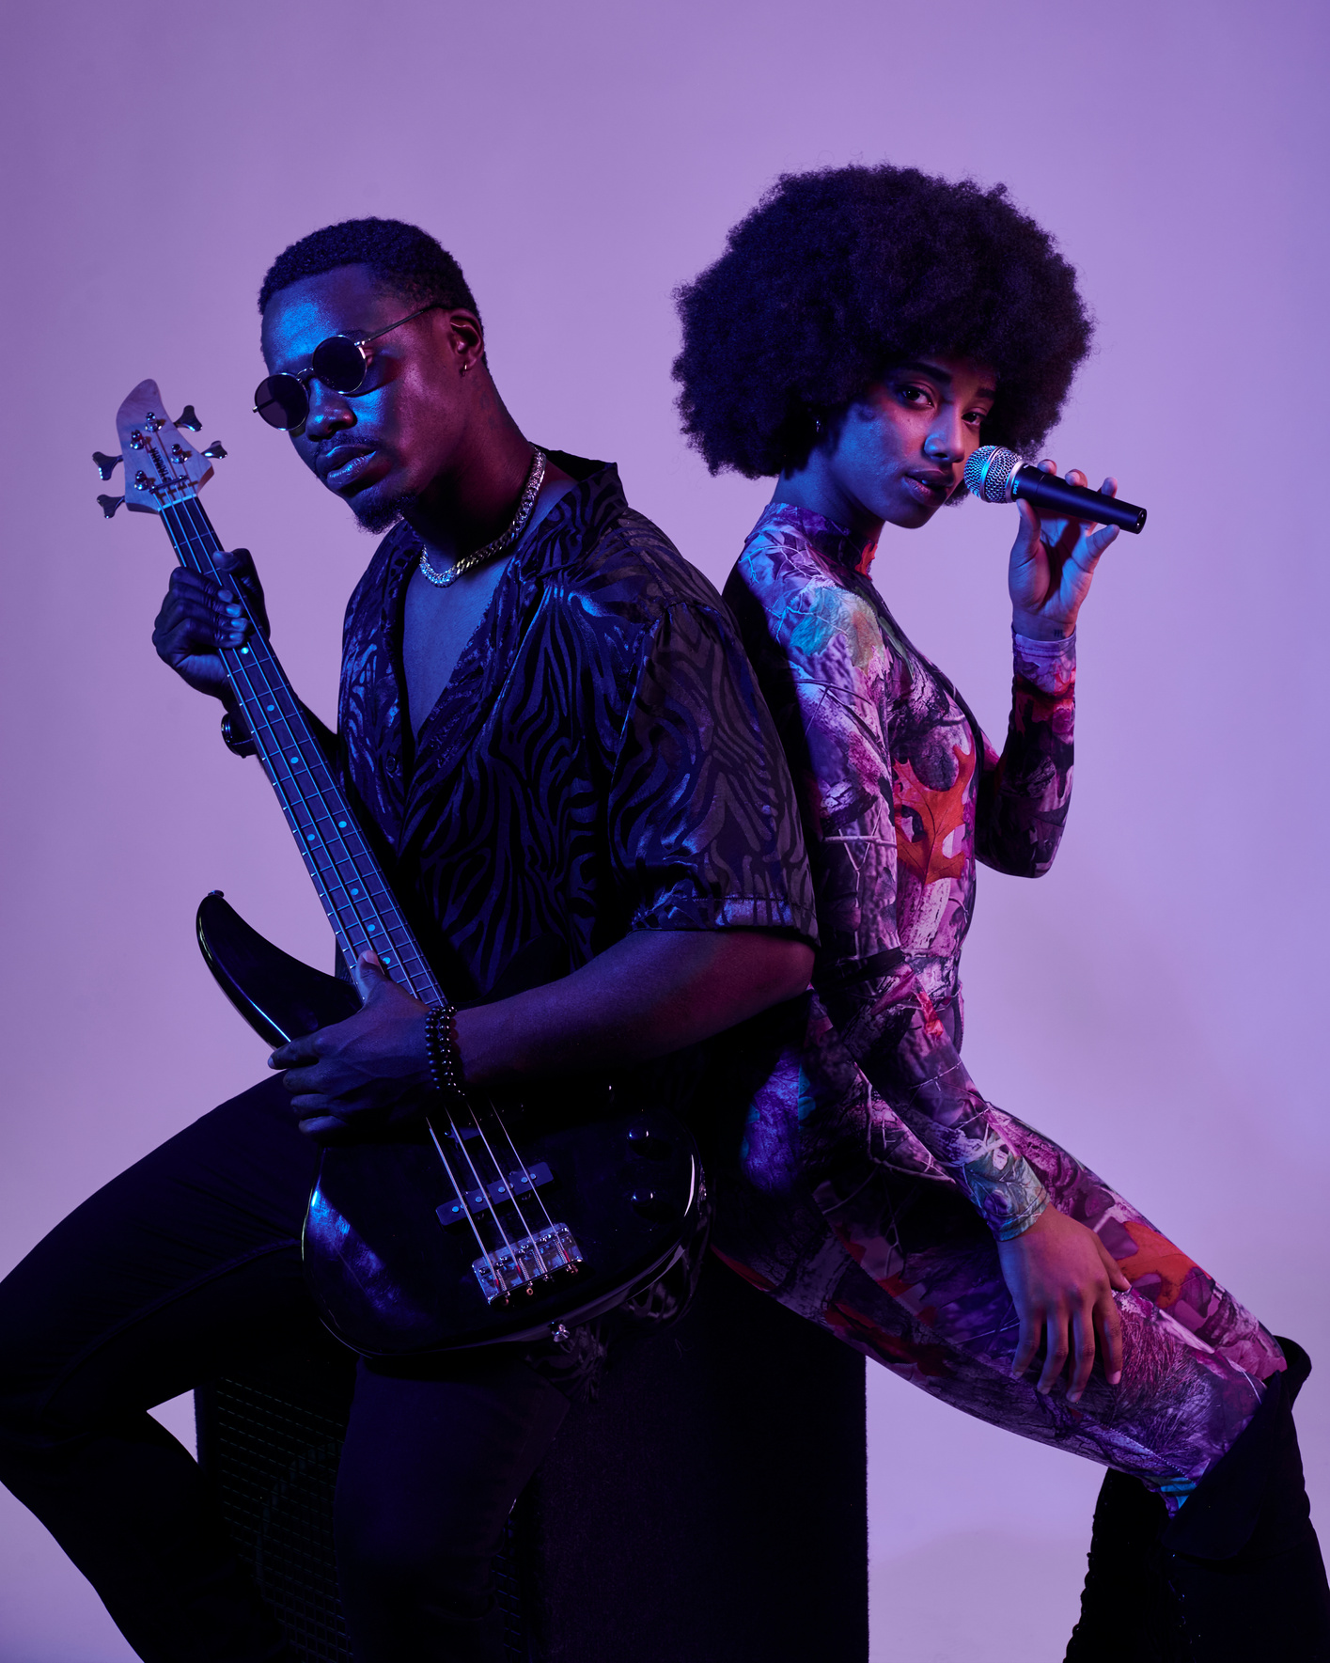
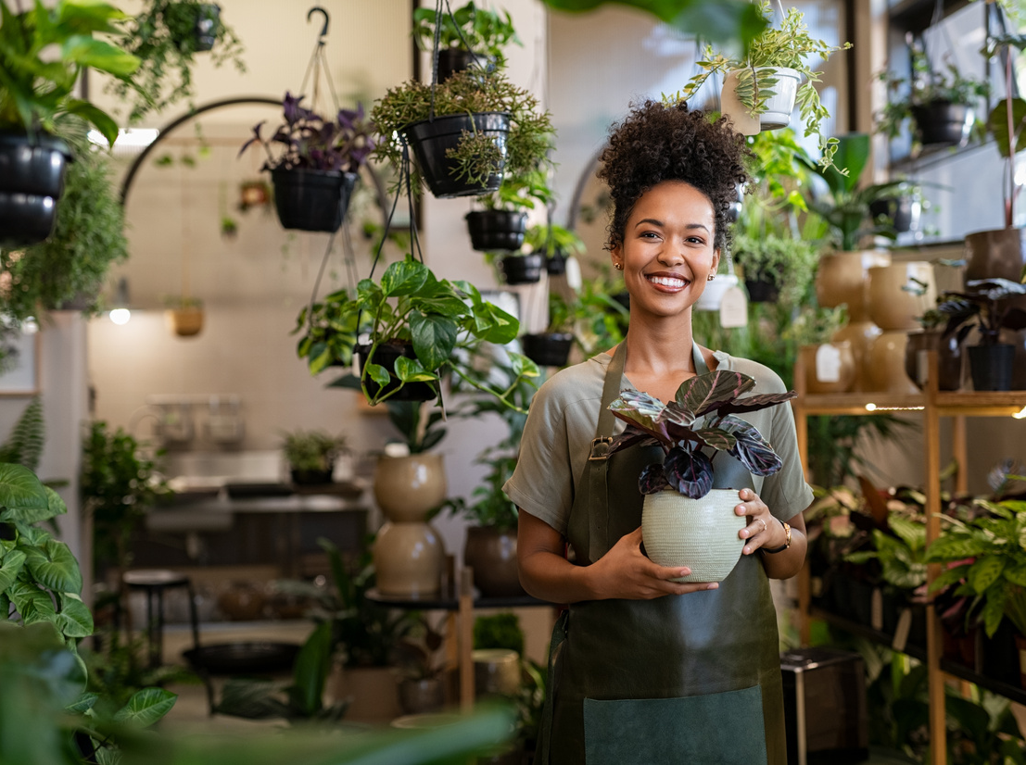

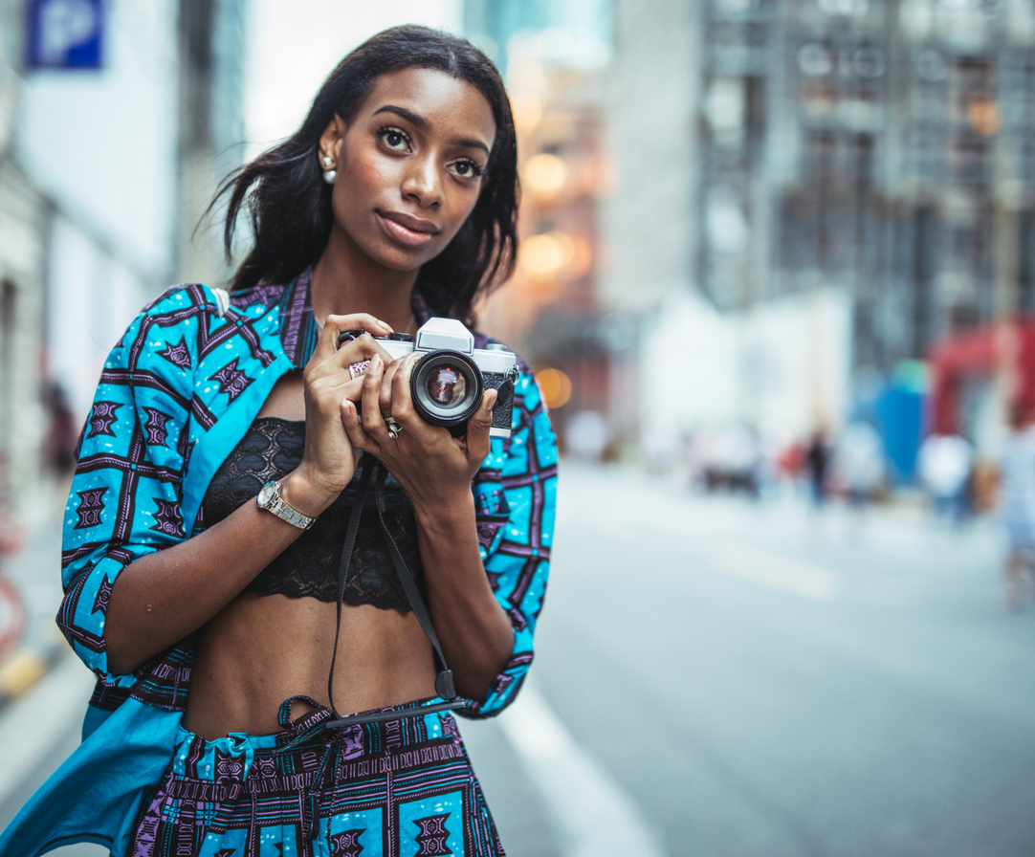
PRIMARY BRAND
IMAGERY

Slide 14




CATEGORICAL
ICONOGRAPHY
Brick & Mortar
Products & Services
Professionals
Creatives
Events
Jobs

Slide 15
DIGITAL PRESENCE
Hashtags, Music, & Playlists
Brand Imagery is one tool within your Brand Identity kit that defines the aesthetic appearance of your brand's core messaging. Brand imagery is one visual story-telling component of the E-22 Brand Identity, and must be adhered to in order to maintain the brand's integrity.
THE BLAC LIST
Find and Be Found
DIGITAL PRESENCE

Slide 16

HASHTAGS
THE BLAC LIST
We recommend utilizing at least 1 brand-approved hashtag from each row for the appropriate social media platform.
The BLACQList
theblacqlist
theblacqlist
PLATFORM | Instagram
IMAGE/PICTURE RELEVANT/CONTENT SPECIFIC | #BlackGirlMagic, #BlackCreatives, #BlackBoyJoy, #BlackExcellence, #BlackBeauty, #BlackInnovators, #BlackTalent, #BlackCraftsmanship, #BlackArtistry, #BlackVisionary
COMMUNITY BASED | #SupportBlackBusinesses, #BlackOwnedBusiness, #BlackOwnedBusinesses, #BlackDollar, #BlackCommunity, #BuyBlack, #BlackVoices, #BlackEmpowerment, #BlackSolidarity, #BlackLivesMatter
OWN BRAND | #TheBLACQList, #BLACQListed, #BLACQBusinesses, #BLACQProfessionals, #BLACQCreatives, #BLACQEvents, #BLACQJobs, #BLACQListExplore
DAILY HASHTAGS | #MondayMotivation, #TuesdayTalents, #WednesdayWins, #ThursdayThoughts, #FridayFeeling, #SaturdayShoutout, #SundaySpotlight, #WeekendVibes, #MidweekMomentum, #FridayFavorites

Slide 17
HASHTAGS
THE BLAC LIST
We recommend utilizing at least 1 brand-approved hashtag from each row for the appropriate social media platform.
The BLACQList
theblacqlist
theblacqlist
PLATFORM | Instagram
TARGET AUDIENCE SEARCHES | #BlackOwnedBusinesses, #BlackBusinessNearMe, #ExploreBlackBusinesses #BlackBusinessDirectory, #BlackEvents, #BlackOwnedNailSalon, #BlackArtist
INDUSTRY | #BuyBlack, #BlackEconomy, #BlackFashion, #BlackEntertainment, #BlackHealth, #BlackWellness, #BlackEducation, #BlackWeddings, #BlackRetail, #BlackServices
LOCATION | #BlackOwnedNYC, #BlackOwnedLA, #BlackOwnedATL, #BlackOwnedChicago, #BlackOwnedHouston, #BlackOwnedMiami, #BlackOwnedDallas, #BlackOwnedPhilly, #BlackOwnedDetroit, #BlackOwnedSeattle
NICHE | #BlackOwnedBoutiques, #BlackVeganEateries, #BlackTechStartups, #BlackOwnedBookstores, #BlackHairCareBrands, #BlackOwnedJewelryDesigners, #BlackCraftsmenWorkshops, #BlackHolisticWellness, #BlackOwnedSkincareBrands, #BlackCulturalGalleries

Slide 18
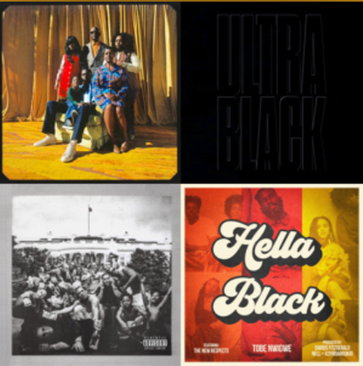
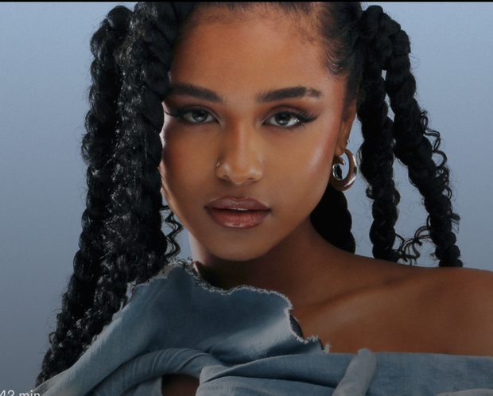
MUSIC & PLAYLISTS
Musical Representation
The BLACQList thrives off modern Black Excellence rooted in unity and collective purpose. This brand’s musical representation should reflect current and culturally relevant messages of Black excellence, and empowerment, with an R&B sensibility.
Black Pride & Power
https://open.spotify.com/playlist/4RajV8Som6AAY6nozcOPaK?si=c28e1ca026564c3b
RNB X
https://open.spotify.com/playlist/4RajV8Som6AAY6nozcOPaK?si=c28e1ca026564c3b

Slide 19

THE BLAC LIST
Find and Be Found

